Slide 1
SECURE DATA HIDING IN IMAGES USING STEGANOGRAPHY
CAPSTONE PROJECT
Presented By
Student Name : Ayush Kant
College Name: IIITDM Kurnool
Department: Computer Science & Engineering

Slide 2
OUTLINE
Problem Statement
Technology used
Wow factor
End users
Result
Conclusion
Git-hub Link
Future scope

Slide 3
Problem Statement
In an age where data security is paramount, traditional encryption methods are often easily detectable and can raise suspicion. There is a growing need for innovative ways to hide confidential messages within seemingly innocuous cover images, ensuring that sensitive information remains secure while the integrity of the cover image is maintained. Moreover, making these encryption and decryption processes accessible to non-technical users through a simple, user-friendly interface is crucial. This project addresses these challenges by implementing a steganography-based solution that seamlessly integrates advanced encryption techniques with a responsive and interactive GUI.

Slide 4
Technology used
Libraries:
PIL (Pillow), OS, Hashlib, Tkinter, Filedialog, Messagebox
Language:
Python 3
System Requirements:
Operating System: Windows 11 Home
Processor: AMD Ryzen 5500U
RAM: 16 GB
Software: Visual Studio Code, OpenStego

Slide 5
Wow factors
Interactive and Responsive:
The GUI is designed to be user-friendly, making it easy for users to navigate through the encryption and decryption processes.
Interactive elements ensure a smooth and intuitive experience.
Advanced Encryption Standard (AES 128 Bit):
The project employs AES (128 Bit) encryption for an additional layer of security.
The secret message is encrypted using a passcode before being embedded in the image.
User-Friendly:
The application features a visually appealing and vibrant interface.
Clear prompts and error messages guide users through the process.
Double Protection:
The secret message is first encrypted using a passcode and then hidden in the image, ensuring double protection.
This two-step security measure makes unauthorized access extremely difficult.

Slide 6
End users
Some Potential End Users are :
Journalists and Whistleblowers
Cybersecurity Experts
Government and Military Personnel
Academics and Researchers
Personal Use
Banks and Financial sectors
Privacy Enthusiasts

Slide 7
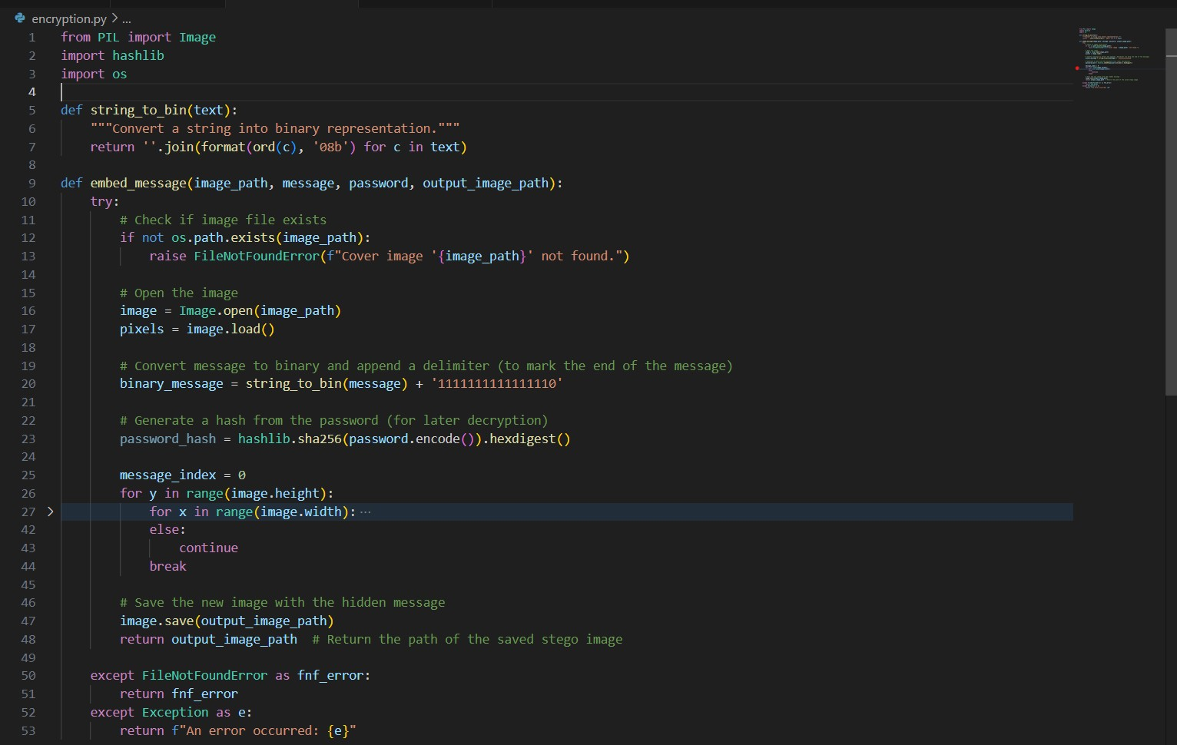
Results
Encryption Code

Slide 8
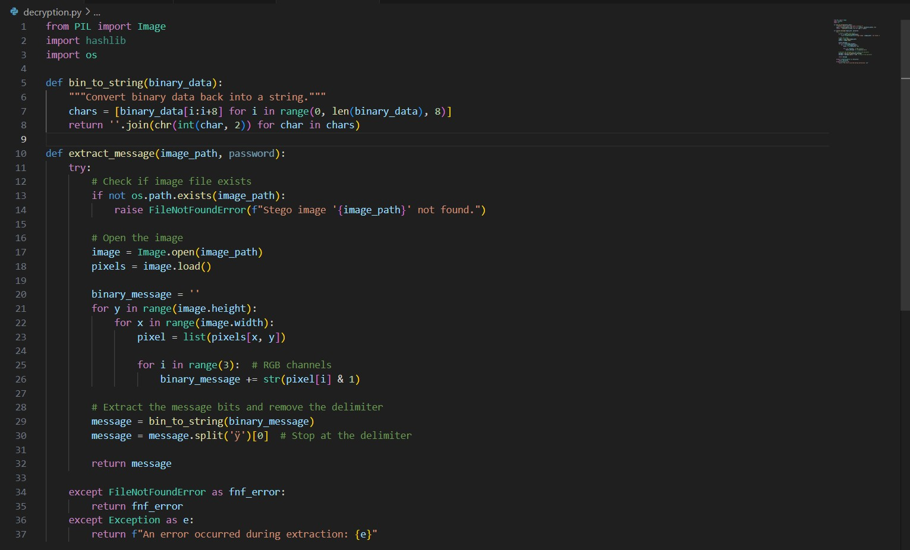
Results
Decryption Code

Slide 9
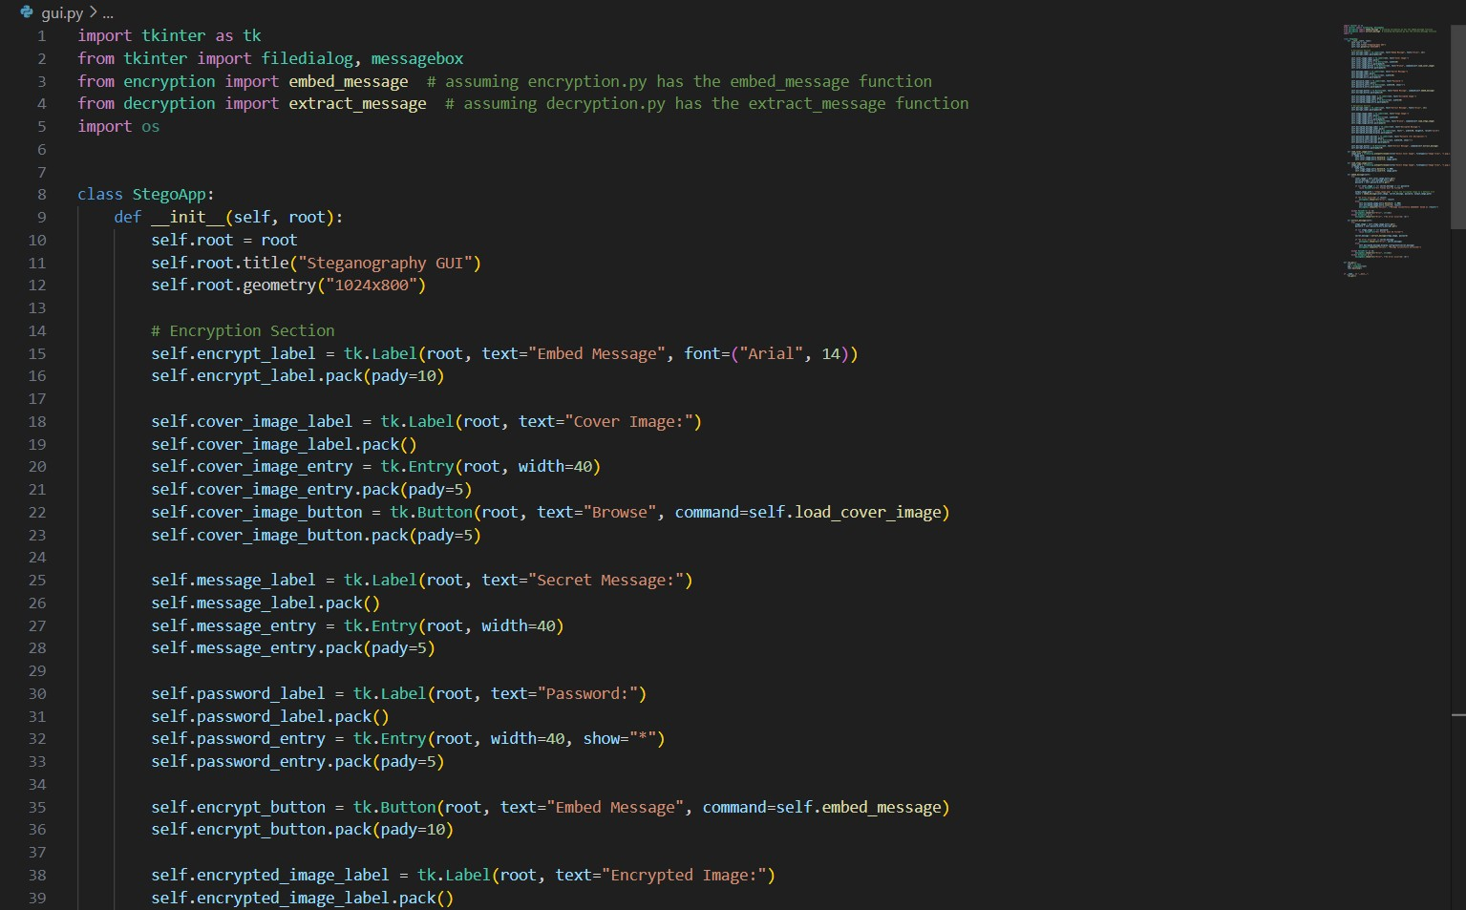
Results
GUI Code

Slide 10
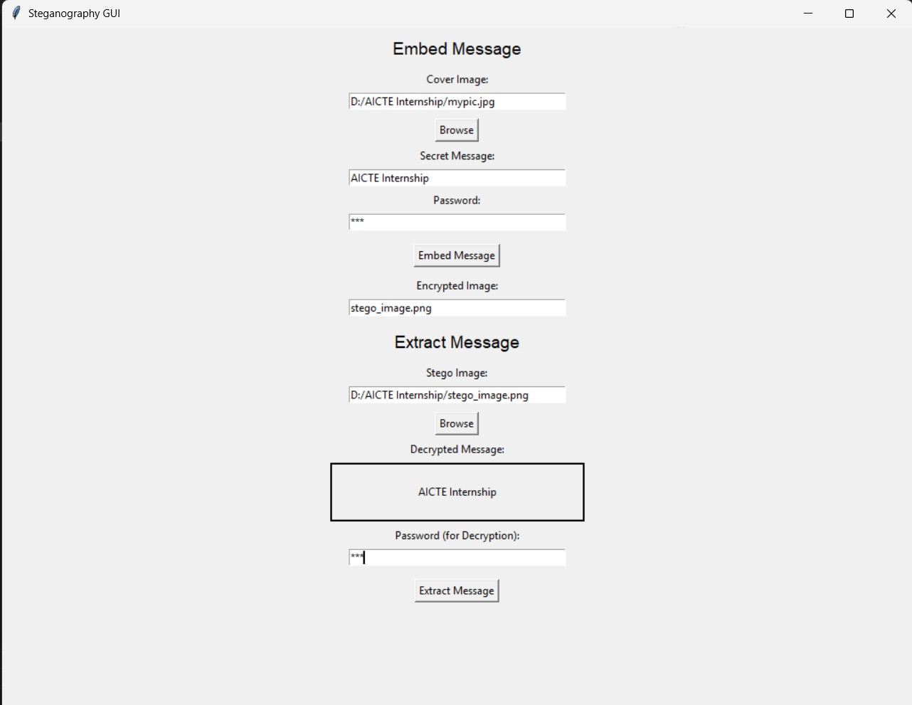
Results
Input And Output

Slide 11
Conclusion
The "Secure Data Hiding in Images Using Steganography" project successfully demonstrates the application of
steganography for securely hiding confidential messages within images. By leveraging advanced encryption
techniques, such as AES, and implementing a user-friendly graphical interface, I have provided an effective
solution for secure data transmission that maintains the integrity of the cover image.
My key achievements include the implementation of robust encryption and decryption processes, and the
development of an interactive and responsive GUI using tkinter . These features make the encryption and
decryption processes accessible to non-technical users, enhancing the overall usability of the application.
Looking ahead, there is significant potential for integrating more advanced encryption methods like AES-256,
AES-512, and RSA. Additionally, expanding the capability to use various file types as cover files and hidden data
will further enhance the versatility and applicability of this solution. This project lays a strong foundation for
future enhancements, ensuring its relevance and effectiveness in addressing evolving data security needs.

Slide 12
GitHub Link
https://github.com/Ayushk500/Steganography.git

Slide 13
Future scope(optional)
Advanced Encryption Methods:
Integrating more robust and advanced encryption methods like AES-256, AES-512, and RSA to enhance security.
Multiple Cover File Types:
Enabling the selection of various types of cover files, such as music, video, PDF, and more, instead of just images.
This allows for greater flexibility and applicability in different scenarios.
Hiding Different File Formats:
Expanding the capability to hide various file formats, including videos, audio files, and documents, facilitating
safe sharing of diverse types of data between parties.
Cross-Platform Compatibility:
Enhancing the software to be compatible across different operating systems and devices, including macOS, Linux,
and mobile platforms, ensuring wider accessibility and usability.

Slide 14
THANK YOU

